Slide 1

Preprocessing
Dustin Carrión

Slide 2
Basic Steps
Import the libraries.
Import the dataset.
Process missing data (optional).
Process categorical variables (optional).
Split the dataset into train and test.
Scaling/normalization/standardization.

Slide 3

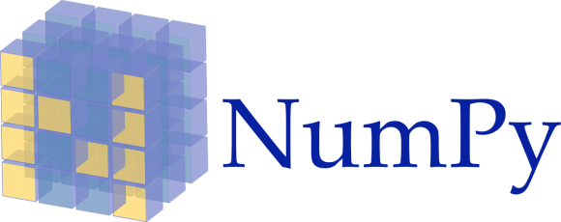


Import the libraries

Slide 4
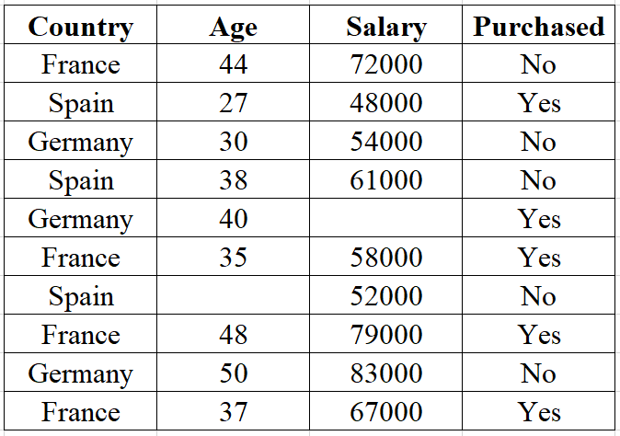
Import the dataset

Slide 5
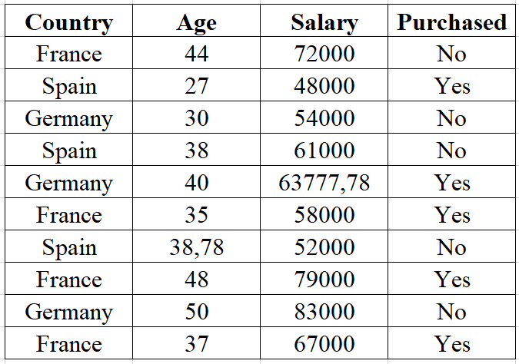
Process missing data (Imputing)
Mean <- Most used
Median
More frequent
Constant

Slide 6
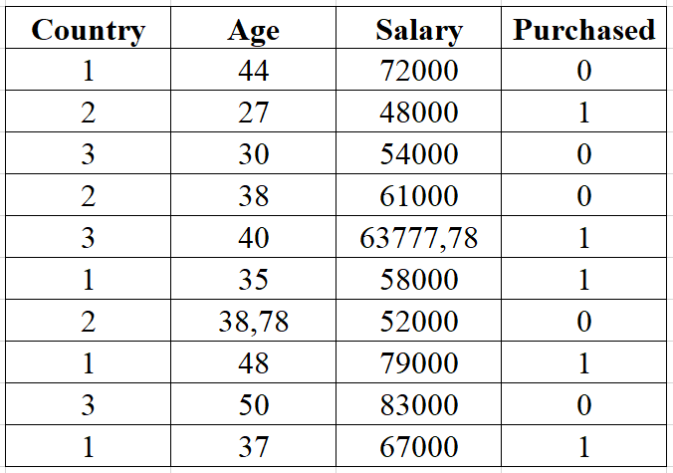
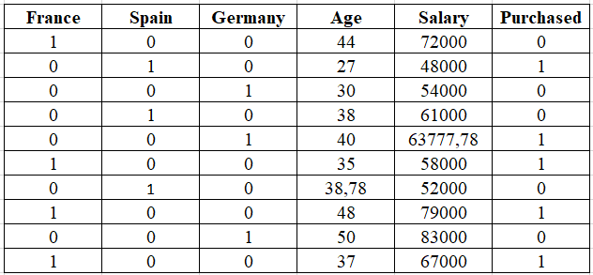

Process categorical variables

Slide 7
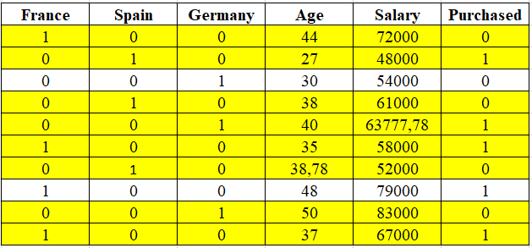
Split the dataset into train and test

Slide 8
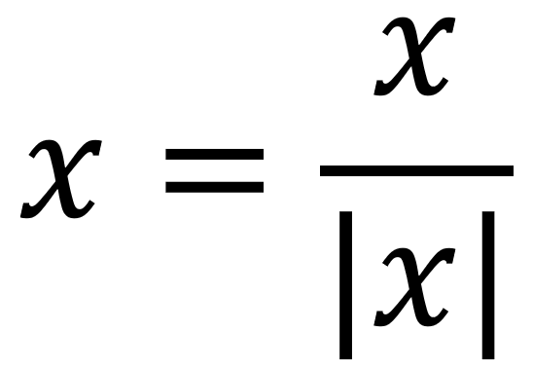
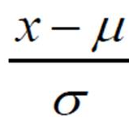

Scaling
Normalization
Standardization
Min/Max

Slide 9
References
All this course is based on the Udemy course “Machine Learning A-Z™: Hands-On Python & R In Data Science” created by Kirill Eremenko, Hadelin de Ponteves, SuperDataScience Team, SuperDataScience Support.
(https://www.udemy.com/course/machinelearning/)

Slide 10

General Information
Place:
B-101
Meetings:
Tuesday 20:00 – 21:00
Facebook Group: CLUB DE DESARROLLO DE VIDEOJUEGOS E INTELIGENCIA ARTIFICIAL YACHAY TECH
GitHub: https://github.com/yachay-tech-ai

